Slide 1

Predicting Customer Booking Behavior
Using machine learning to identify high-intent customers and optimize conversion strategies in airline commerce.

Slide 2

The Business Challenge: Converting Flight Searches into Bookings
A supervised learning model was developed using 50,000 historical records of flight search and booking data to predict customer conversion likelihood.
The dataset revealed a significant class imbalance-only 15% of customers who searched actually completed a booking, presenting both a challenge and an opportunity for targeted intervention.

Slide 3




Feature Engineering: Turning Data into Insights
Route Intelligence
Behavioral Patterns
Origin-destination parsing and route popularity metrics
Purchase lead time, length of stay, and flight duration bins
Timing Factors
Purchase Signals
Flight daypart analysis and time-based preferences
Trip type interactions, sales channel, and ancillary add-ons
Light but explainable feature engineering strengthened predictive power while maintaining model interpretability for business stakeholders.

Slide 4
Model Performance: Strong Results with Real Business Impact
0.79
0.39
43.8%
2.9x
ROC-AUC Score
PR-AUC Score
Top Decile Precision
Conversion Uplift
Test set performance indicating strong discriminative ability
Precision-recall performance on imbalanced data
Booking rate among highest-scored customers
Improvement over 15% baseline booking rate
The RandomForest classifier (300 estimators, class-balanced weighting) was trained with stratified 80/20 split and validated using 3-fold cross-validation, ensuring robust and generalizable predictions.

Slide 5
Key Drivers of Booking Propensity
Feature importance analysis revealed five critical factors that drive customer booking decisions:
01
02
03
Purchase Lead Time
Length of Stay
Flight Hour Preference
Early planners show significantly higher conversion rates
Longer trip durations correlate with booking completion
Time-of-day preferences signal purchase intent
04
05
Booking Origin
Route Popularity
Geographic patterns indicate market-specific behaviors
Demand concentration on key routes drives conversions

Slide 6
Business Recommendations: Maximize ROI Through Precision Targeting
1
2
3
Target the Top 10%
Optimize Channel Mix
Monitor and Retrain
Focus marketing efforts on customers in the highest-scoring decile, where precision reaches 43.8% nearly 3× the baseline conversion rate.
Deploy low-cost digital channels (email, push notifications, retargeting ads) to engage high-intent customers efficiently and reduce acquisition costs.
Implement continuous monitoring for data drift and schedule periodic model retraining to sustain performance as travel patterns evolve.
These strategies offer a clear path to improving conversion rates while reducing marketing spend through data-driven customer segmentation.
By deploying this model, British Airways can capture high-value bookings more effectively, improving conversion rates while optimizing marketing spend.

Slide 7
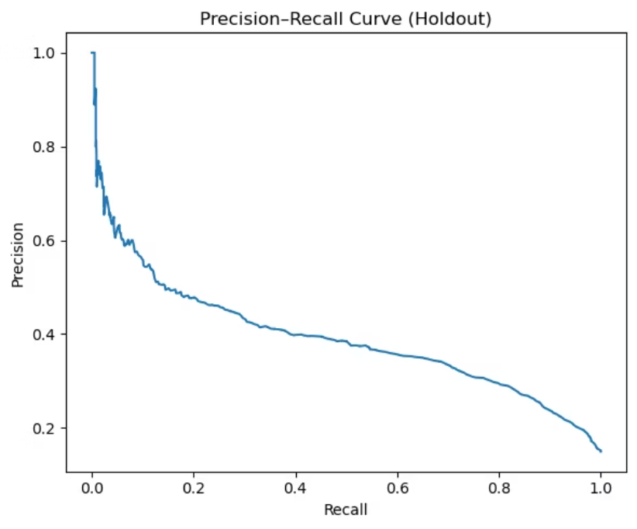
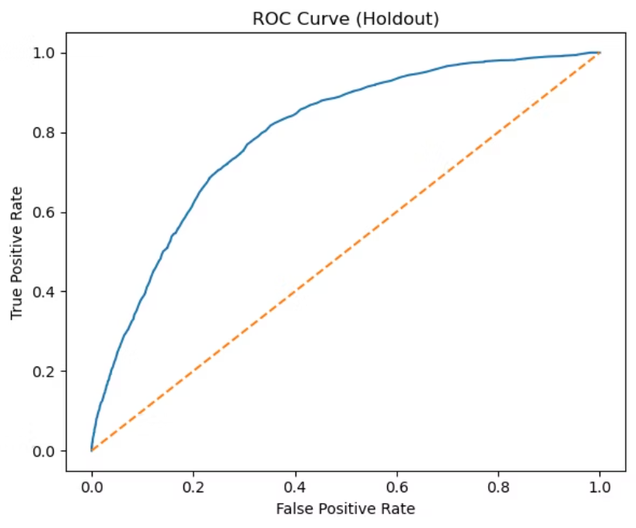
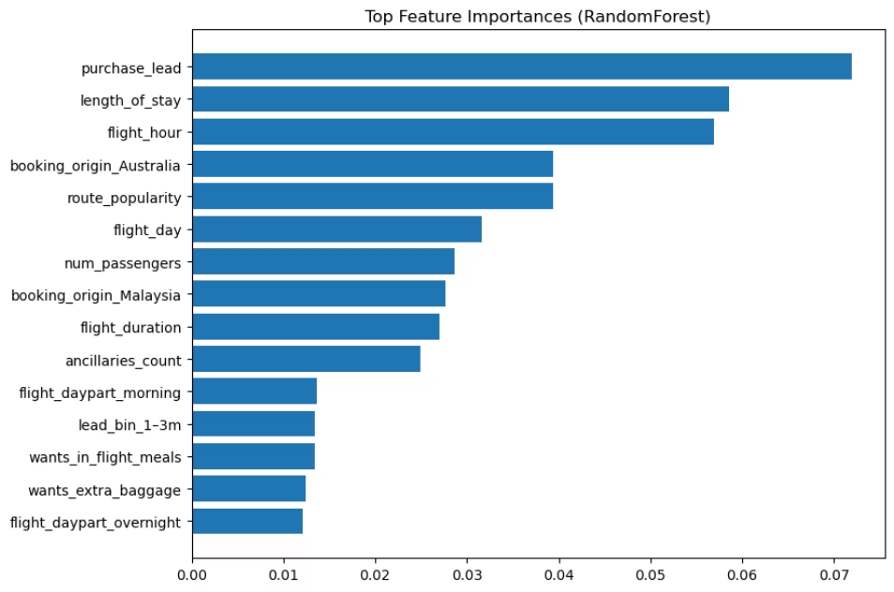
Model Results Overview
Precision-Recall, ROC,
Feature Importances & Top-K Metrics

